Slide 1
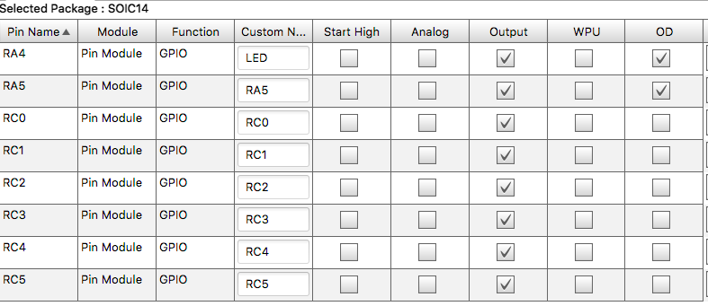
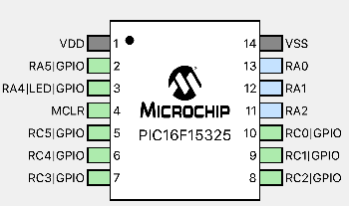
gnd
+5V
pot
4.7k
+5V
gnd
gnd
gnd
gnd
gnd
gnd
gnd
gnd
+5V
100k
14 13 12 11 10 9 8
1 2 3 4 5 6 7 8 9 10 11 12 13 14 15 16
PIC16F15325
C1602A-V1.2 16x2 LCD
1 2 3 4 5 6 7
+5V
1k
+5V
gnd
4.7k
R
G Y
+5V
DS18B20
1Wire Temperature Sensor

Slide 2
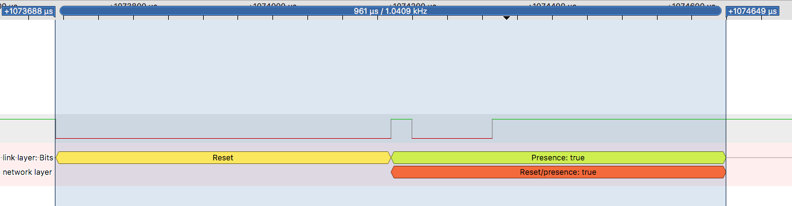
30
115

Slide 3
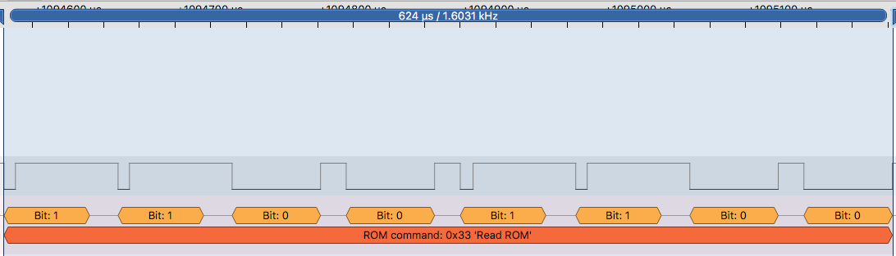
8
72
8
72
20 – between bits
60 – bit length

Slide 4
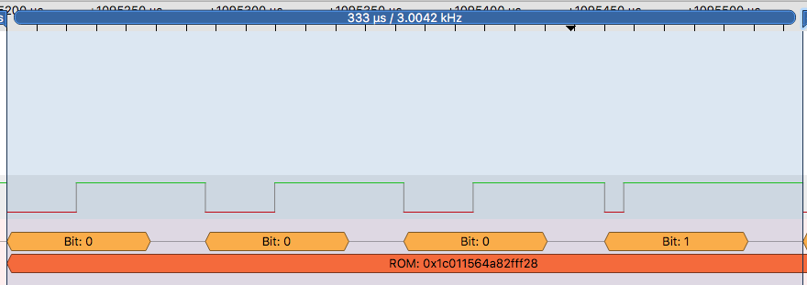

Slide 5
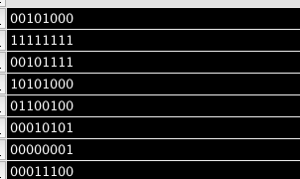
LSB -> MSB
0001 0100
1111 1111
1111 0100
0001 0101
0010 0110
1010 1000
1000 0000
0011 1000
Matches binary string on wire

Slide 6
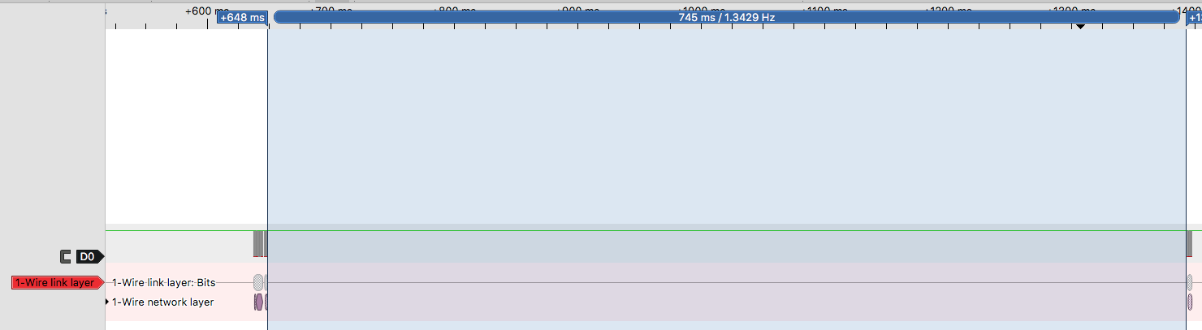
OW_reset_pulse();
OW_reset_pulse();
OW_write_byte(0xCC);
OW_write_byte(0x44);
OW_reset_pulse();
OW_write_byte(0xCC);
OW_write_byte(0xBE);

Slide 7
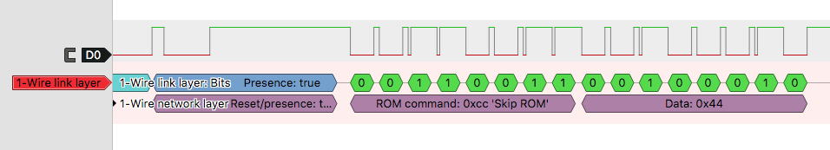
Binary representation of the temperature

